Slide 1
Customer’s booking prediction.
Fitting a Machine learning model for predicting customer’s booking pattern.

Slide 2
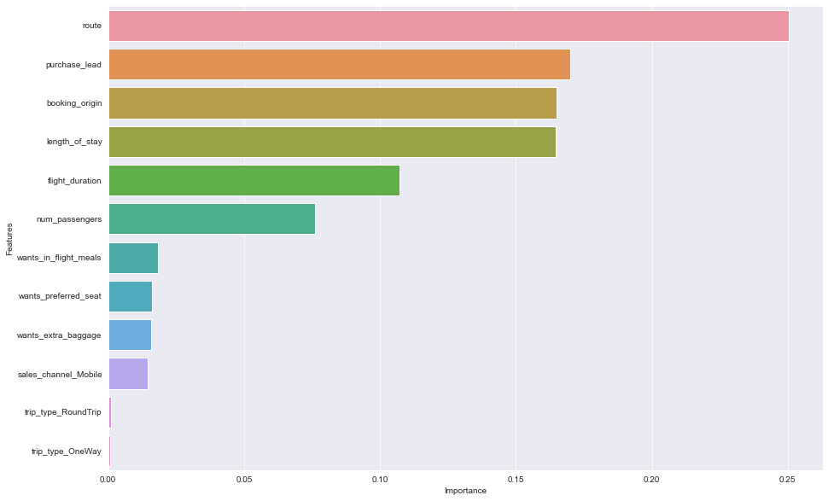
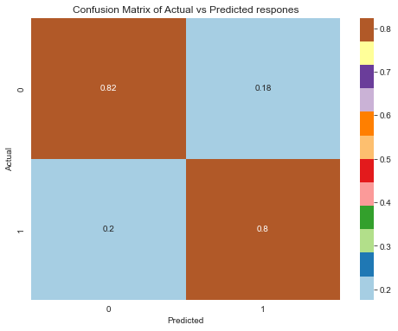
Model fitting:-
The Top 10 important features obtained during model evaluation are :-
We fitted a Machine learning model using Random Forest Classifier algorithm which gave us 81.2% accuracy while predicting the taste data with a precision of 81.9% while classifying the responses. It also gave us a recall score of 80.08%. The overall Prediction power of this model is far greater than other fitted models based on Logistic regression , Decision Tree classifier ,Supported Vector Machine etc. The confusion Metrics obtained for the Model is given below.

